Slide 1
TASK Analysis:

Slide 2
The notion of a ‘task’ has been central to work in human–computer interaction since the subject started.
Undertaking a task analysis is a very useful technique – or rather set of techniques – for understanding people and how they carry out their work.

Slide 3
Looking at the tasks that people do, or the tasks that they will have to do because of some redesigned system, is a necessary part of human-centred design.

Slide 4
What is Task Analysis?
Methods to analyse people's jobs:
what people do
what things they work with
what they must know

Slide 5
An Example
in order to clean the house
get the vacuum cleaner out
fix the appropriate attachments
clean the rooms
when the dust bag gets full, empty it
put the vacuum cleaner and tools away
must know about:
vacuum cleaners, their attachments, dust bags, cupboards, rooms etc.

Slide 6
Approaches to task analysis
Task decomposition
splitting task into (ordered) subtasks
Knowledge based techniques
what the user knows about the task and how it is organised
Entity/object based analysis
relationships between objects, actions and the people who perform them
lots of different notations/techniques

Slide 7
general method
observe
collect unstructured lists of words and actions
organize using notation or diagrams

Slide 8
Differences from other techniques
Systems analysis vs. Task analysis
system design - focus - the user
Cognitive models vs. Task analysis
internal mental state - focus - external actions
practiced `unit' task - focus - whole job

Slide 9
Task Decomposition
Aims: describe the actions people do structure them within task subtask hierarchy describe order of subtasks
Variants: Hierarchical Task Analysis (HTA) most common CTT (CNUCE, Pisa) uses LOTOS temporal operators

Slide 10
Textual HTA description
Hierarchy description ...
0. in order to clean the house
1. get the vacuum cleaner out
2. get the appropriate attachment
3. clean the rooms
3.1. clean the hall
3.2. clean the living rooms
3.3. clean the bedrooms
4. empty the dust bag
5. put vacuum cleaner and attachments away
... and plans
Plan 0: do 1 - 2 - 3 - 5 in that order. when the dust bag gets full do 4
Plan 3: do any of 3.1, 3.2 or 3.3 in any order depending on which rooms need cleaning
N.B. only the plans denote order

Slide 11
Generating the hierarchy
1 get list of tasks
2 group tasks into higher level tasks
3 decompose lowest level tasks further
Stopping rules How do we know when to stop? Is “empty the dust bag” simple enough? Purpose: expand only relevant tasks Motor actions: lowest sensible level

Slide 12
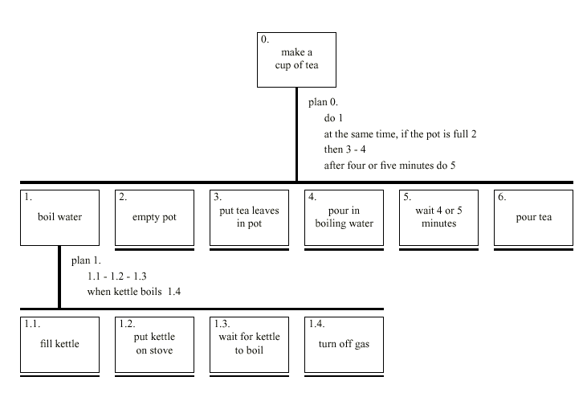
Diagrammatic HTA

Slide 13
There are many different techniques, focussing on different aspects of task:
structure of interest (time, movement, goals hierarchy, or the task hierarchy),
ease of learning,
the knowledge required, and
user's conceptual representation of the task.

Slide 14
The goals of task analysis vary too, covering such things as:
predicting usability of a new system,
explaining previous error and error patterns,
assessing changes in job requirements, and
assessing system complexity.

Slide 15
task is a very nebulous term and needs to be set in the context of many other things that people do, such as:
work,
activities,
tasks,
operations, and
actions.

Slide 16
The Use of Task Analysis in Human Factors
Task analysis has two key roles in human factors:
1. enable us to describe and understand behaviour - especially given that actual and supposed behaviour in organisations is different.
2.Let us to understand how well a new system 'fits' the old system. Given a task analysis of how people currently do a task, or would conceive of doing the task we can ask how much that overlaps with the formal analysis of how it should be done in the new system.

Slide 17
Ways to TA
Hierarchal Task analysis
Logical Task analysis
Cognitive Task Analysis
GOAMS
KLMS

